Slide 1


ADICHUNCHANAGIRI INSTITUTE OF TECHNOLOGY,
CHIKKAMAGALURU
DEPARTMENT OF COMPUTER SCIENCE & ENGINEERING
PROJECT PRESENTATION
ON
“IMAGE STEGANOGRAPHY USING QUANTUM TECHNOLOGY”
Under the Guidance of
Mr. MANIKANTA PRASAD J B.E.,M.Tech..
Assistant Professor,
Department of Computer Science & Engineering
Presented By
Diwakar N (4AI21CS029) Rathan M E (4AI21CS076)
A N Karanjith (4AI21CS001) Mohammed Asim Farhan (4AI20CS057)

Slide 2

ABSTRACT
Developing a novel image steganography technique using quantum-inspired principles.
Leveraging randomness and superposition-like transformations for enhanced security.
Embedding secret data within images at a granular pixel level.
Providing a more secure method compared to traditional steganography techniques.
Ensuring confidentiality during data transmission.
Enhancing complexity to thwart unauthorized access and ensure data integrity.
Applying quantum-like operations to increase unpredictability and resist detection by advanced steganalysis techniques.
2

Slide 3
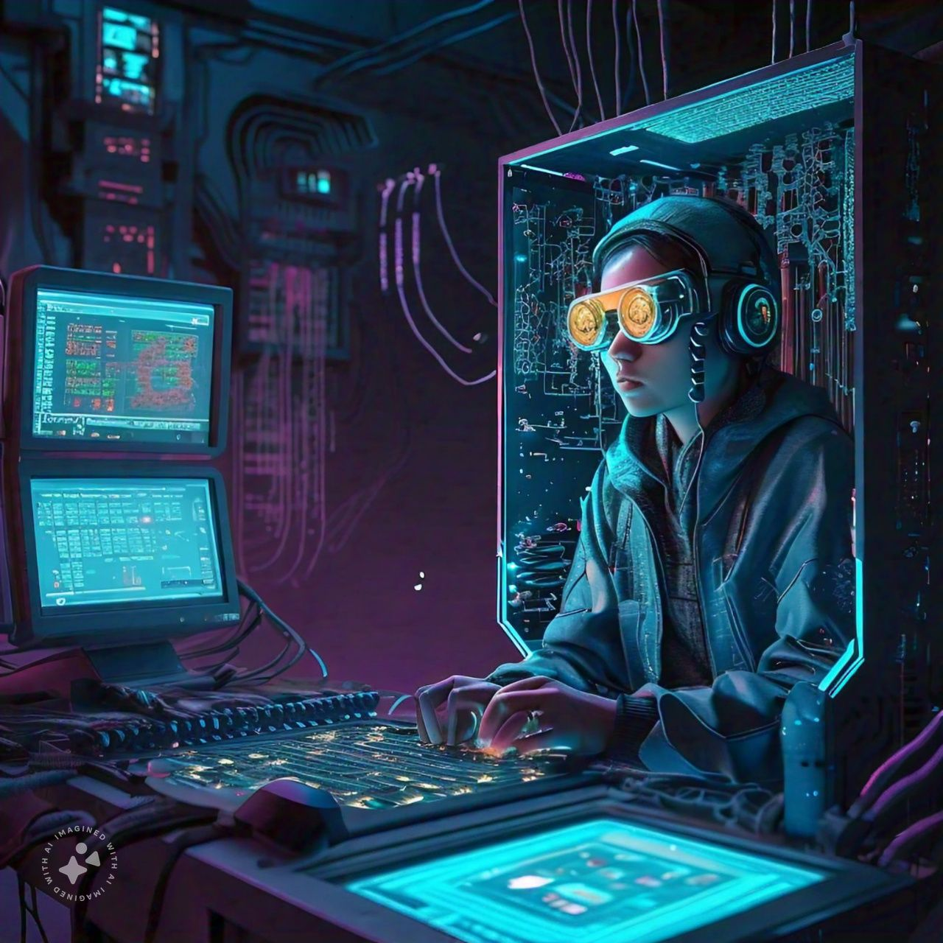
AGENDA
Introduction​
Literature Survey
Motivation
Problem Statement​
Input Images (Instead of Dataset)
Scope of the project​
Objectives​
System Requirement Specification ​
Architecture diagram​
Flow chart
Board work
Conclusion
References​
3

Slide 4
INTRODUCTION
OVERVIEW OF PROJECT
Advanced Security: The project introduces quantum-inspired randomness and superposition, making image steganography more resistant to detection by modern steganalysis techniques.
Innovative Encoding: By using quantum-like transformations, the encoding process becomes highly unpredictable, enhancing the security of hidden data.
Practical Application: A Flask-based web platform allows users to seamlessly upload images and embed messages, ensuring both usability and robust data concealment​​
4

Slide 5
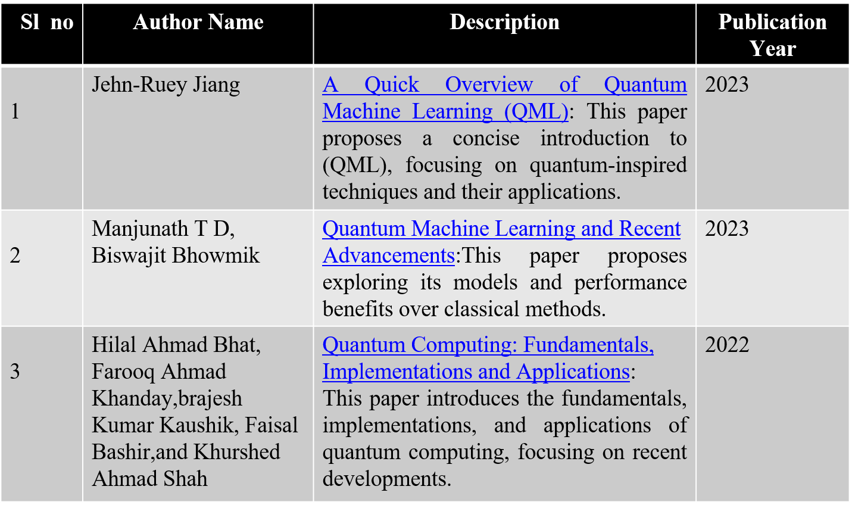
LITERATURE SURVEY:
5

Slide 6
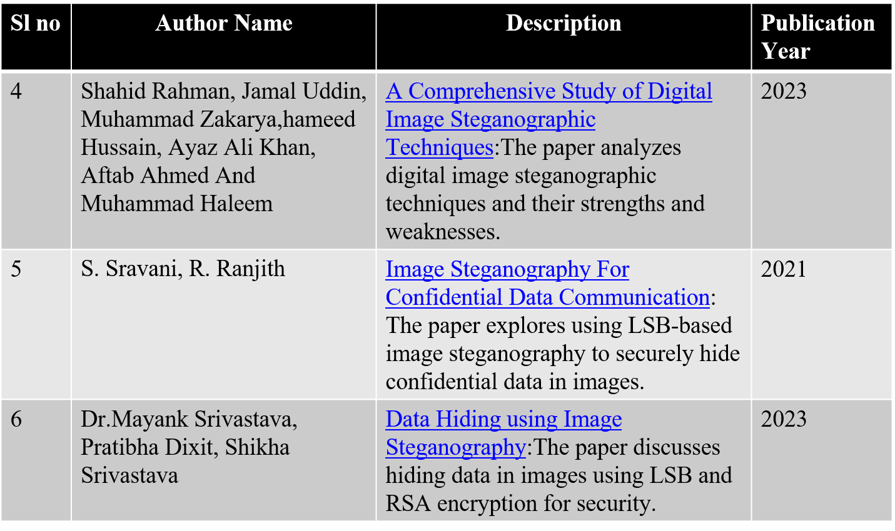
6

Slide 7
SYSTEM REQUIREMENTS
SOFTWARE REQUIREMENTS:
Operating system : Windows 10/11.
Software Tools : Visual Studio Code.
Coding Languages : Python,HTML,CSS
HARDWARE REQUIREMENTS:
System : Intel Core i3\i5\i7\i9.
Hard Disk : Minimum 100GB.
Ram : Minimum 4 GB
7

Slide 8
MOTIVATION
Vulnerabilities in Traditional Methods: Common techniques like LSB encoding are increasingly susceptible to modern steganalysis, exposing the need for more secure approaches to conceal hidden data.
Growing Demand for Secure Communication: As cyber-attacks rise, safeguarding sensitive information through covert communication methods has become crucial, particularly in fields like national security and financial systems.
Quantum-Inspired Security Enhancement: This project implements quantum-inspired randomness and superposition, offering a more secure and unpredictable data embedding process that overcomes the limitation of traditional steganography.
8

Slide 9
PROBLEM STATEMENT
“To design and implement a quantum-inspired image steganography system”
Input:
A digital image file in which the secret data will be embedded.
A text string containing the message that needs to be hidden.
Process:
Data Embedding: Process the image pixel by pixel, using quantum-inspired transformations to embed the secret message in the least significant bits (LSB).
Data Complexity Enhancement: Apply randomized bit manipulations to increase complexity, mimicking quantum superposition and entanglement.
Output:
Phase-1: A modified image that visually appears identical to the original but contains the embedded secret data.
Phase-2: The hidden message can be extracted from the modified image through a decoding process.
9

Slide 10
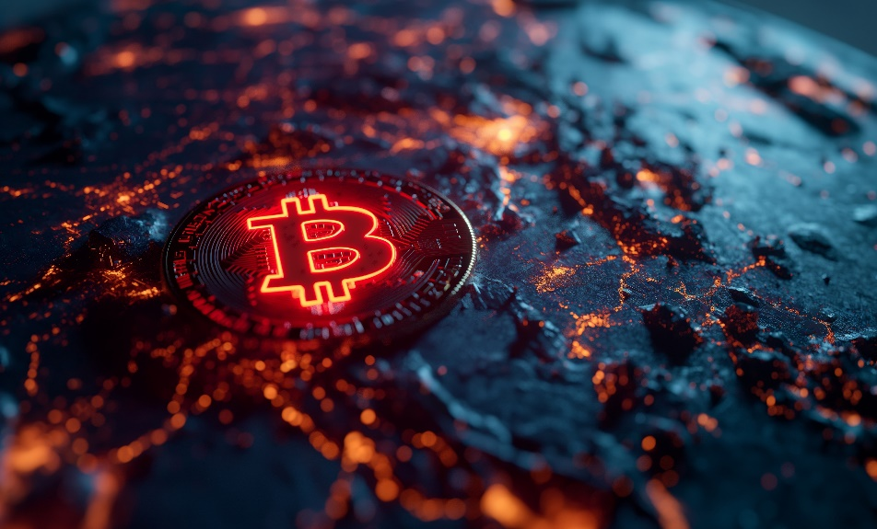
Input Images (Instead of Dataset)
Dimension : 5696 x 3392 Width : 5696 pixels Height : 3392 pixels Type of file : JPEG file(.jpeg) Size : 7.49 MB
Horizontal Resolution : 72 dpi
Vertical Resolution : 72 dpi
pic1.jpeg
10

Slide 11
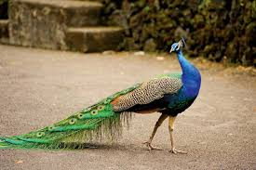
Input Images (Instead of Dataset)
Dimension : 5620 x 3330 Width : 5620 pixels Height : 3330 pixels Type of file : JPEG file(.jpeg) Size : 6.49 MB
Horizontal Resolution : 68 dpi
Vertical Resolution : 68 dpi
pic2.jpeg
11

Slide 12
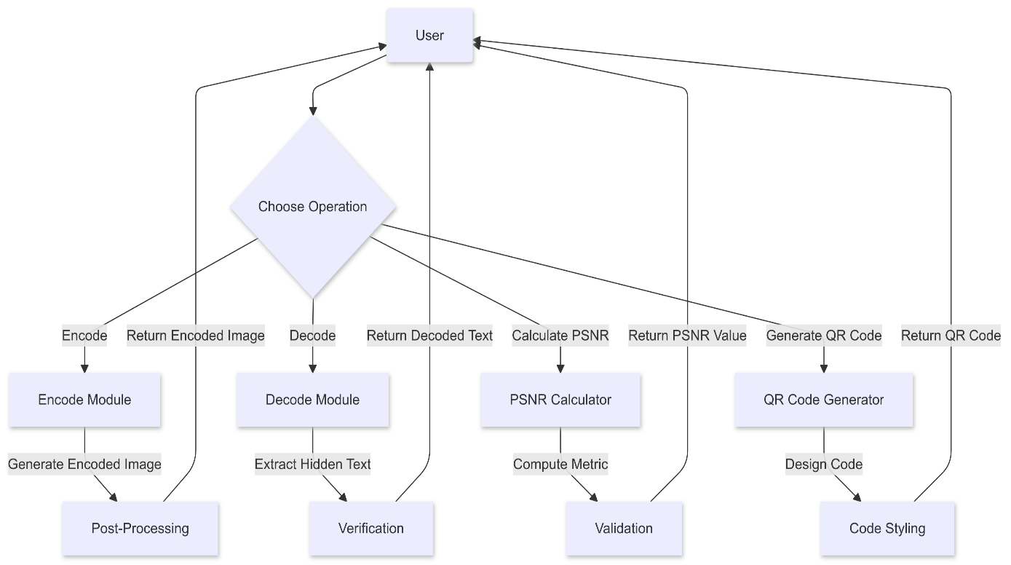
DATA FLOW DIAGRAM (DFD)
Figure : DFD for the Steganographic Processing and Analysis Module

Slide 13
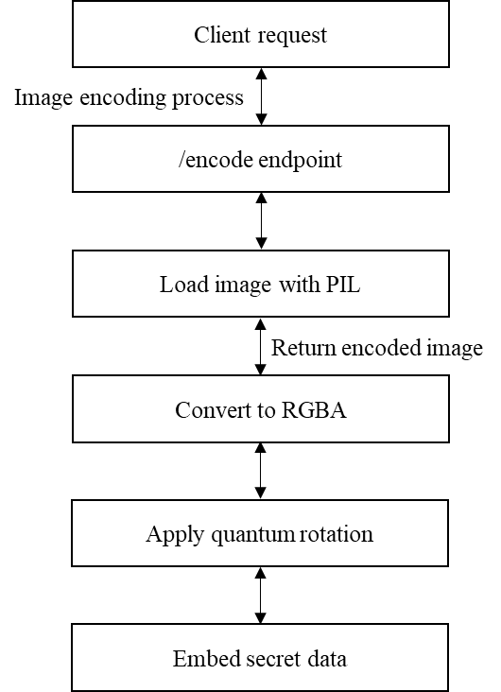
DATA FLOW DIAGRAM (DFD)
DFD for the Module (POST /encode with image and text):
Input: The process starts with a Client request.
Process: The image is processed through the /encode endpoint, converted to RGBA, a quantum rotation is applied, and secret data is embedded.
Output: The modified image containing the embedded secret data is returned to the client.
Figure: DFD for the Module (POST /encode with image and text)

Slide 14
DATA FLOW DIAGRAM (DFD)
DFD for the Module (POST /decode with image):
Input: Client request to decode an image.
Process: The image is decoded using the /decode endpoint.
Output: The decoded image is passed to the "Load encoded image" process.
Figure: DFD for the Module (POST /encode with image and text)

Slide 15
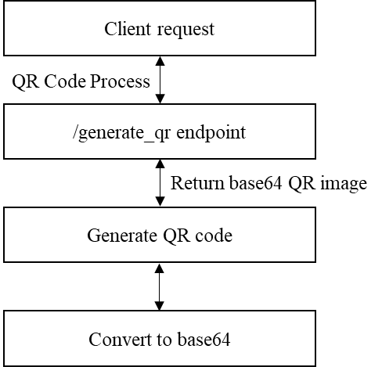
DATA FLOW DIAGRAM (DFD)
DFD for the Module (POST /generate_qr with text):
Input: Client request to generate a QR code.
Process: The QR code is generated using the /generate_qr endpoint.
Output: The generated QR code is passed to the "Convert to base64" process.
Figure: DFD for the Module (POST /generate_qr with text)

Slide 16
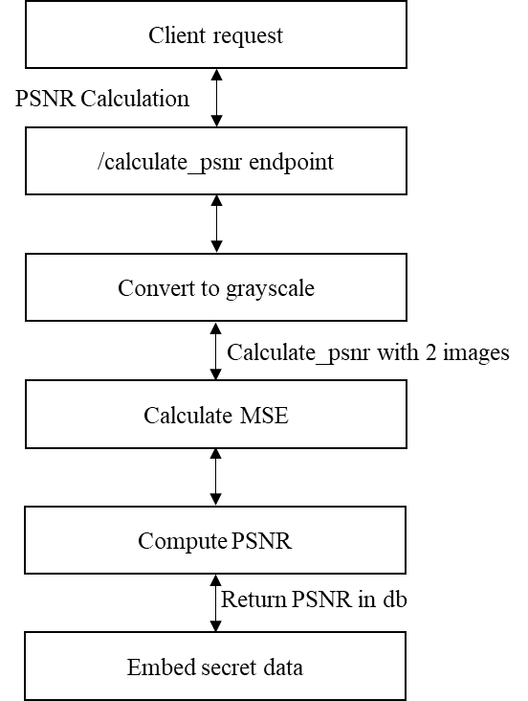
DATA FLOW DIAGRAM (DFD)
DFD for the PSNR calculation Module:
Input: Grayscale images.
Process: Mean Squared Error (MSE) is calculated between the grayscale images.
Output: Calculated MSE is passed to the "Compute PSNR" process.
Figure: DFD for the Module PSNR calculation Module

Slide 17
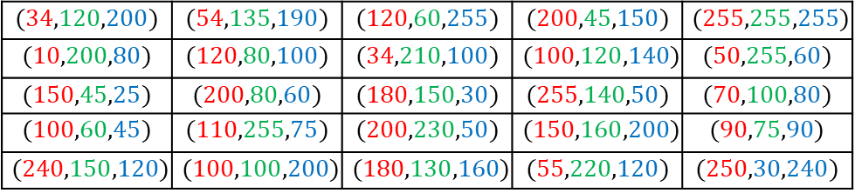
BOARD WORK
QNN Algorithm Working
Input: Initial 5x5 Image Matrix
$$(34,120,200)$$ | $$(54,135,190)$$ | $$(120,60,255)$$ | $$(200,45,150)$$ | $$(255,255,255)$$
$$(10,200,80)$$ | $$(120,80,100)$$ | $$(34,210,100)$$ | $$(100,120,140)$$ | $$(50,255,60)$$
$$(150,45,25)$$ | $$(200,80,60)$$ | $$(180,150,30)$$ | $$(255,140,50)$$ | $$(70,100,80)$$
$$(100,60,45)$$ | $$(110,255,75)$$ | $$(200,230,50)$$ | $$(150,160,200)$$ | $$(90,75,90)$$
$$(240,150,120)$$ | $$(100,100,200)$$ | $$(180,130,160)$$ | $$(55,220,120)$$ | $$(250,30,240)$$
12

Slide 18
Tracing
Image Matrix (3x3 pixels, RGB values):
BOARD WORK
Secret Data (Message: "HII"):
H = 01001000 (binary)
I = 01001001 (binary)
I = 01001001 (binary)
The secret message is 01001000 01001001 01001001
1.Red Channel:The first bit in the message is 0 (for 01001000).
2.Green Channel:The second bit in the message is 1 (for 01001001).
3.Blue Channel:The third bit in the message is 0 (for 01001001).
13

Slide 19
BOARD WORK
$$(34,120,200)$$ | $$(54,135,190)$$ | $$(120,60,255)$$ | $$(200,45,150)$$ | $$(255,255,255)$$
1.(34,120,200):
Red (R=34) → 00100010 (binary)
The LSB is 0, which matches the first bit (0) → No change.
Green (G=120) → 01111000 (binary)
The LSB is 0, which does not matches the second bit (1) → Change.
New Green: 01111001 → 121 (decimal).
Blue (B=200) → 11001000 (binary)
The LSB is 0, which matches the third bit (0) → No change.
Updated pixel : (34, 121, 200)
14

Slide 20
BOARD WORK
2.(54,135,190):
Red (R=54) → 00110110 (binary)
The LSB is 0, which matches the first bit (0) → No change.
Green (G=135) → 10000111 (binary)
The LSB is 1, which matches the second bit (1) → No Change.
Blue (B=190) → 10111110 (binary)
The LSB is 0, which matches the third bit (0) → No change.
Updated pixel : (54, 135, 190)
15

Slide 21
BOARD WORK
3.(120,60,255):
Red (R=120) → 01111000 (binary)
The LSB is 0, which matches the first bit (0) → No change.
Green (G=60) → 00111100 (binary)
The LSB is 0, which does not matches the second bit (1) → Change.
New Green: 00111101 → 61 (decimal).
Blue (B=255) → 11111111 (binary)
The LSB is 1, which does not matches the third bit (0) → Change.
New Blue: 11111110 → 254 (decimal).
Update pixel : (120, 61, 254)
16

Slide 22
BOARD WORK
4.(200,45,150):
Red (R=200) → 11001000 (binary)
The LSB is 0, which matches the first bit (0) → No change.
Green (G=135) → 00101101 (binary)
The LSB is 1, which matches the second bit (1) → No Change.
Blue (B=150) → 10010110 (binary)
The LSB is 0, which matches the third bit (0) → No change.
Updated pixel : (200, 45, 150)
17

Slide 23
BOARD WORK
5.(255,255,255):
Red (R=255) → 11111111 (binary)
The LSB is 0, which does not matches the first bit (0) → Change.
New Red: 11111110 → 254 (decimal).
Green (G=255) → 11111111 (binary)
The LSB is 1, which matches the second bit (1) → No Change.
Blue (B=255) → 11111111 (binary)
The LSB is 0, which does not matches the third bit (0) → Change.
New Blue: 11111110 → 254 (decimal).
Updated pixel : (254, 255, 254)
18

Slide 24
BOARD WORK
$$(10,200,80)$$ | $$(120,80,100)$$ | $$(34,210,100)$$ | $$(100,120,140)$$ | $$(50,255,60)$$
1.(10,200,80):
Red (R=10) → 00001010 (binary)
The LSB is 0, which matches the first bit (0) → No change.
Green (G=200) → 11001000 (binary)
The LSB is 0, which does not matches the second bit (1) → Change.
New Green: 11001001 → 201 (decimal).
Blue (B=80) → 01010000 (binary)
The LSB is 0, which matches the third bit (0) → No change.
Updated pixel : (10, 201, 80)
19

Slide 25
BOARD WORK
2.(120,80,100):
Red (R=120) → 01111000 (binary)
The LSB is 0, which matches the first bit (0) → No change.
Green (G=80) → 01010000 (binary)
The LSB is 0, which does not matches the second bit (1) → Change.
New Green: 01010001 → 81 (decimal).
Blue (B=100) → 01100100 (binary)
The LSB is 0, which matches the third bit (0) → No change.
Updated pixel : (120, 81, 100)
20

Slide 26
BOARD WORK
3.(34,210,100):
Red (R=34) → 00100010 (binary)
The LSB is 0, which matches the first bit (0) → No change.
Green (G=210) → 11010010 (binary)
The LSB is 0, which does not matches the second bit (1) → Change.
New Green: 11010011 → 211 (decimal).
Blue (B=100) → 01100100 (binary)
The LSB is 0, which matches the third bit (0) → No change.
Updated pixel : (34, 211, 100)
21

Slide 27
BOARD WORK
4.(100,120,140):
Red (R=100) → 01100100 (binary)
The LSB is 0, which matches the first bit (0) → No change.
Green (G=120) → 01111000 (binary)
The LSB is 0, which does not matches the second bit (1) → Change.
New Green: 01111001 → 121 (decimal).
Blue (B=140) → 10001100 (binary)
The LSB is 0, which matches the third bit (0) → No change.
Updated pixel : (100, 121, 140)
22

Slide 28
BOARD WORK
5.(50,255,60):
Red (R=50) → 00110010 (binary)
The LSB is 0, which matches the first bit (0) → No change.
Green (G=255) → 11111111 (binary)
The LSB is 1, which matches the second bit (1) → No Change.
Blue (B=60) → 00111100 (binary)
The LSB is 0, which matches the third bit (0) → No change.
Updated pixel : (50, 255, 60)
23

Slide 29
BOARD WORK
$$(150,45,25)$$ | $$(200,80,60)$$ | $$(180,150,30)$$ | $$(255,140,50)$$ | $$(70,100,80)$$
1.(150,45,25):
Red (R=150) → 10010110 (binary)
The LSB is 0, which matches the first bit (0) → No change.
Green (G=45) → 00101101 (binary)
The LSB is 1, which matches the second bit (1) → No Change.
Blue (B=25) → 00011001 (binary)
The LSB is 1, which does not matches the third bit (0) → Change.
New Blue: 00011000 → 24 (decimal).
Updated pixel : (150, 45, 24)
24

Slide 30
BOARD WORK
2.(200,80,60):
Red (R=200) → 11001000 (binary)
The LSB is 0, which matches the first bit (0) → No change.
Green (G=80) → 01010000 (binary)
The LSB is 0, which does not matches the second bit (1) → Change.
New Green: 01010001 → 81 (decimal).
Blue (B=60) → 10001100 (binary)
The LSB is 0, which matches the third bit (0) → No change.
Updated pixel : (200, 81, 60)
25

Slide 31
BOARD WORK
3.(180,150,30):
Red (R=180) → 10110100 (binary)
The LSB is 0, which matches the first bit (0) → No change.
Green (G=150) → 10010110 (binary)
The LSB is 0, which does not matches the second bit (1) → Change.
New Green: 10010111 → 151 (decimal).
Blue (B=30) → 00011110 (binary)
The LSB is 0, which matches the third bit (0) → No change.
Updated pixel : (180, 151, 30)
26

Slide 32
BOARD WORK
4.(255,140,50):
Red (R=255) → 11111111 (binary)
The LSB is 1, which does not matches the first bit (0) → Change.
New Red: 11111110 → 254 (decimal).
Green (G=140) → 10001100 (binary)
The LSB is 0, which does not matches the second bit (1) → Change.
New Green: 10001101 → 141 (decimal).
Blue (B=50) → 00110010 (binary)
The LSB is 0, which matches the third bit (0) → No change.
Updated pixel : (254, 141,50)
27

Slide 33
BOARD WORK
5.(70,100,80):
Red (R=70) → 01000110 (binary)
The LSB is 0, which matches the first bit (0) → No change.
Green (G=100) → 01100100 (binary)
The LSB is 0, which does not matches the second bit (1) → Change.
New Green: 01100101 → 101 (decimal).
Blue (B=80) → 01010000 (binary)
The LSB is 0, which matches the third bit (0) → No change.
Updated pixel : (70, 101, 80)
28

Slide 34
BOARD WORK
$$(100,60,45)$$ | $$(110,255,75)$$ | $$(200,230,50)$$ | $$(150,160,200)$$ | $$(90,75,90)$$
1.(100,60,45):
Red (R=100) → 01100100 (binary)
The LSB is 0, which matches the first bit (0) → No change.
Green (G=60) → 00111100 (binary)
The LSB is 0, which does not matches the second bit (1) → Change.
New Green: 00111101 → 61 (decimal).
Blue (B=45) → 00101101 (binary)
The LSB is 1, which does not matches the third bit (0) → Change.
New Blue: 00101100 → 61 (decimal).
Updated pixel : (100, 61, 44)
29

Slide 35
BOARD WORK
2.(110,255,75):
Red (R=110) → 01101110 (binary)
The LSB is 0, which matches the first bit (0) → No change.
Green (G=255) → 11111111 (binary)
The LSB is 1, which matches the second bit (1) → No Change.
Blue (B=75) → 01001011 (binary)
The LSB is 1, which does not matches the third bit (0) → Change.
New Blue: 01001010 → 74 (decimal).
Updated pixel : (110, 255, 74)
30

Slide 36
BOARD WORK
3.(200,230,50):
Red (R=200) → 11001000 (binary)
The LSB is 0, which matches the first bit (0) → No change.
Green (G=230) → 11100110 (binary)
The LSB is 0, which does not matches the second bit (1) → Change.
New Green: 11100111 → 231 (decimal).
Blue (B=50) → 00110010 (binary)
The LSB is 0, which matches the third bit (0) → No change.
Updated pixel : (200, 231, 50)
31

Slide 37
BOARD WORK
4.(150,160,200):
Red (R=150) → 10010110 (binary)
The LSB is 0, which matches the first bit (0) → No change.
Green (G=160) → 10100000 (binary)
The LSB is 0, which does not matches the second bit (1) → Change.
New Green: 10100001 → 161 (decimal).
Blue (B=200) → 11001000 (binary)
The LSB is 0, which matches the third bit (0) → No change.
Updated pixel : (150, 161, 200)
32

Slide 38
BOARD WORK
5.(90,75,90):
Red (R=90) → 01011010 (binary)
The LSB is 0, which matches the first bit (0) → No change.
Green (G=75) → 01001011 (binary)
The LSB is 1, which matches the second bit (1) → No change.
Blue (B=90) → 01011010 (binary)
The LSB is 0, which matches the third bit (0) → No change.
Updated pixel : (90, 75, 90)
33

Slide 39
BOARD WORK
$$(240,150,120)$$ | $$(100,100,200)$$ | $$(180,130,160)$$ | $$(55,220,120)$$ | $$(250,30,240)$$
1.(240,150,120):
Red (R=240) → 11110000 (binary)
The LSB is 0, which matches the first bit (0) → No change.
Green (G=150) → 10010110 (binary)
The LSB is 0, which does not matches the second bit (1) → Change.
New Green: 10010111 → 151 (decimal).
Blue (B=120) → 01111000 (binary)
The LSB is 0, which matches the third bit (0) → No change.
Updated pixel : (240, 151, 120)
34

Slide 40
BOARD WORK
2.(100,100,200):
Red (R=100) → 01100100 (binary)
The LSB is 0, which matches the first bit (0) → No change.
Green (G=100) → 01100100 (binary)
The LSB is 0, which does not matches the second bit (1) → Change.
New Green: 01100101 → 101 (decimal).
Blue (B=200) → 11001000 (binary)
The LSB is 0, which matches the third bit (0) → No change.
Updated pixel : (100, 101, 200)
35

Slide 41
BOARD WORK
3.(180,130,160):
Red (R=180) → 10110100 (binary)
The LSB is 0, which matches the first bit (0) → No change.
Green (G=130) → 10000010 (binary)
The LSB is 0, which does not matches the second bit (1) → Change.
New Green: 10000011 → 131 (decimal).
Blue (B=160) → 10100000 (binary)
The LSB is 0, which matches the third bit (0) → No change.
Updated pixel : (180, 131, 160)
36

Slide 42
BOARD WORK
4.(55,220,120):
Red (R=55) → 00110111 (binary)
The LSB is 1, which does not matches the first bit (0) → Change.
New Red: 00110110 → 54 (decimal).
Green (G=220) → 11011100 (binary)
The LSB is 0, which does not matches the second bit (1) → Change.
New Green: 11011101 → 221 (decimal).
Blue (B=120) → 01111000 (binary)
The LSB is 0, which matches the third bit (0) → No change.
Updated pixel : (54, 221,120)
37

Slide 43
BOARD WORK
5.(250,30,240):
Red (R=250) → 11111010 (binary)
The LSB is 0, which matches the first bit (0) → No change.
Green (G=30) → 00011110 (binary)
The LSB is 0, which does not matches the second bit (1) → Change.
New Green: 00011111 → 31 (decimal).
Blue (B=240) → 11110000 (binary)
The LSB is 0, which matches the third bit (0) → No change.
Updated pixel : (250, 31, 240)
38

Slide 44
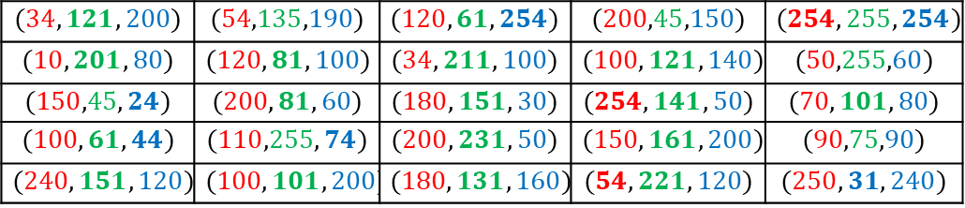
BOARD WORK
Updated 5x5 Image Matrix
$$(34,121,200)$$ | $$(54,135,190)$$ | $$(120,61,254)$$ | $$(200,45,150)$$ | $$(254,255,254)$$
$$(10,201,80)$$ | $$(120,81,100)$$ | $$(34,211,100)$$ | $$(100,121,140)$$ | $$(50,255,60)$$
$$(150,45,24)$$ | $$(200,81,60)$$ | $$(180,151,30)$$ | $$(254,141,50)$$ | $$(70,101,80)$$
$$(100,61,44)$$ | $$(110,255,74)$$ | $$(200,231,50)$$ | $$(150,161,200)$$ | $$(90,75,90)$$
$$(240,151,120)$$ | $$(100,101,200)$$ | $$(180,131,160)$$ | $$(54,221,120)$$ | $$(250,31,240)$$
39

Slide 45
BOARD WORK
We will extract the bits for each pixel, group them into bytes, and convert the binary bytes into ASCII characters.
Decoding for All 25 Pixels
Pixel 1: (34, 121, 200)
R=34 → LSB = 0
G=121 → LSB = 1
B=200 → LSB = 0
Extracted Pixel 2: (54, 135, 190)
R=54 → LSB = 0
G=135 → LSB = 1
B=190 → LSB = 0
40

Slide 46
BOARD WORK
Extracted bits: 010
Pixel 3: (120, 61, 254)
R=120 → LSB = 0
G=61 → LSB = 1
B=254 → LSB = 0
Extracted bits: 010
Pixel 4: (200, 45, 150)
R=200 → LSB = 0
G=45 → LSB = 1
B=150 → LSB = 0
Extracted bits: 010
41

Slide 47
BOARD WORK
Pixel 5: (254, 255, 254)
R=254 → LSB = 0
G=255 → LSB = 1
B=254 → LSB = 0
Extracted bits: 010
Pixel 6: (10, 201, 80)
R=10 → LSB = 0
G=201 → LSB = 1
B=80 → LSB = 0
Extracted bits: 010
42

Slide 48
BOARD WORK
Pixel 7: (120, 81, 100)
R=120 → LSB = 0
G=81 → LSB = 1
B=100 → LSB = 0
Extracted bits: 010
Pixel 8: (34, 211, 100)
R=34 → LSB = 0
G=211 → LSB = 1
B=100 → LSB = 0
Extracted bits: 010
43

Slide 49
BOARD WORK
Pixel 9: (100, 121, 140)
R=100 → LSB = 0
G=121 → LSB = 1
B=140 → LSB = 0
Extracted bits: 010
Pixel 10: (50, 255, 60)
R=50 → LSB = 0
G=255 → LSB = 1
B=60 → LSB = 0
Extracted bits: 010
44

Slide 50
BOARD WORK
Pixel 11: (150, 45, 24)
R=150 → LSB = 0
G=45 → LSB = 1
B=24 → LSB = 0
Extracted bits: 010
Pixel 12: (200, 81, 60)
R=200 → LSB = 0
G=81 → LSB = 1
B=60 → LSB = 0
Extracted bits: 010
45

Slide 51
BOARD WORK
Pixel 13: (180, 151, 30)
R=180 → LSB = 0
G=151 → LSB = 1
B=30 → LSB = 0
Extracted bits: 010
Pixel 14: (254, 141, 50)
R=254 → LSB = 0
G=141 → LSB = 1
B=50 → LSB = 0
Extracted bits: 010
46

Slide 52
BOARD WORK
Pixel 15: (70, 101, 80)
R=70 → LSB = 0
G=101 → LSB = 1
B=80 → LSB = 0
Extracted bits: 010
Pixel 16: (100, 61, 44)
R=100 → LSB = 0
G=61 → LSB = 1
B=44 → LSB = 0
Extracted bits: 010
47

Slide 53
BOARD WORK
Pixel 17: (110, 255, 74)
R=110 → LSB = 0
G=255 → LSB = 1
B=74 → LSB = 0
Extracted bits: 010
Pixel 18: (200, 231, 50)
R=200 → LSB = 0
G=231 → LSB = 1
B=50 → LSB = 0
Extracted bits: 010
48

Slide 54
BOARD WORK
Pixel 19: (150, 161, 200)
R=150 → LSB = 0
G=161 → LSB = 1
B=200 → LSB = 0
Extracted bits: 010
Pixel 20: (90, 75, 90)
R=90 → LSB = 0
G=75 → LSB = 1
B=90 → LSB = 0
Extracted bits: 010
49

Slide 55
BOARD WORK
Pixel 23: (180, 131, 160)
R=180 → LSB = 0
G=131 → LSB = 1
B=160 → LSB = 0
Extracted bits: 010
Pixel 24: (54, 221, 120)
R=54 → LSB = 0
G=221 → LSB = 1
B=120 → LSB = 0
Extracted bits: 010
50

Slide 56
BOARD WORK
Pixel 25: (250, 31, 240)
R=250 → LSB = 0
G=31 → LSB = 1
B=240 → LSB = 0
Extracted bits: 010
Step 2: Group into Bytes
Combine all extracted bits sequentially: 010 010 010 010 010 010 010 010 010 010 010 010 010 010 010 010 010 010 010 010 010 010 010 010 010
51

Slide 57
BOARD WORK
This gives:
First byte: 01001000 (H)
Second byte: 01001001 (I)
Third byte: 01001001 (I)
Final Decoded Message
The ASCII characters for the bytes form the message: "HII".
This completes decoding for all 25 pixels.
52

Slide 58
IMPLEMENTATION
Psedocode for Quantum-inspired image encoding and decoding flask application
START
# Initialize Flask application
DEFINE Flask app
# Define helper function: normalize_to_quantum_state(value)
RETURN rotation angle based on value
# Define helper function: apply_quantum_rotation(value, angle)
RETURN adjusted pixel value
53

Slide 59
IMPLEMENTATION
# Define helper function: encode_image(img, data)
CONVERT image to RGBA
CONVERT image to NumPy array
ADD null character to data
CONVERT data to binary bits
INITIALIZE data_index to 0
FOR each pixel pair in image:
MODIFY least significant bits of RGB using data bits
54

Slide 60
IMPLEMENTATION
APPLY quantum transformations
UPDATE pixel with new values
RETURN modified image
# Define helper function: decode_image(img)
CONVERT image to RGBA
CONVERT image to NumPy array
READ least significant bits of RGB for all pixels
CONVERT bits to characters
55

Slide 61
IMPLEMENTATION
STOP at null character
RETURN decoded text
# Route: Generate QR Code (POST)
DEFINE /generate_qr
VALIDATE input text
GENERATE QR code with input text
SAVE QR code to memory
RETURN QR code as a downloadable file
56

Slide 62
IMPLEMENTATION
# Route: Decode QR Code (POST)
DEFINE /decode_qr
VALIDATE uploaded file
CONVERT image to grayscale
DECODE QR code from image
RETURN decoded text OR error message
57

Slide 63
IMPLEMENTATION
# Route: Encode Data into Image (POST)
DEFINE /encode
VALIDATE uploaded image and secret data
OPEN image
ENCODE secret data into image
SAVE encoded image to memory
RETURN encoded image as a downloadable file
58

Slide 64
IMPLEMENTATION
# Route: Decode Data from Image (POST)
DEFINE /decode
VALIDATE uploaded image
OPEN image
DECODE secret data from image
RETURN decoded data
59

Slide 65
IMPLEMENTATION
# Route: Home Page (GET)
DEFINE /
RENDER home page
# Run Flask application
START app with debug mode
END
60

Slide 66
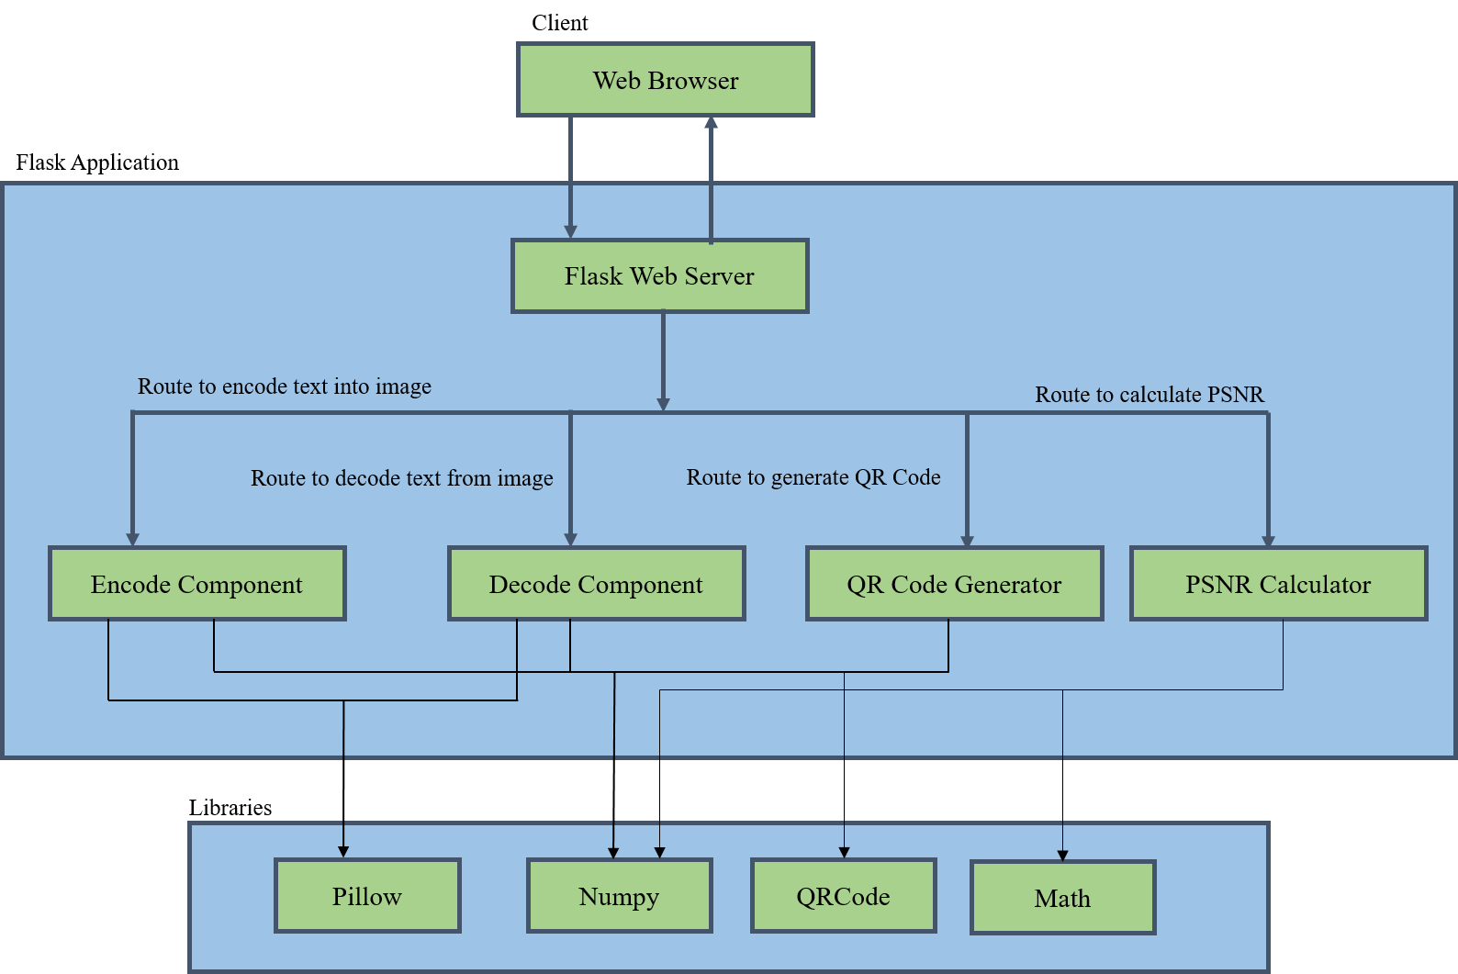
SYSTEM ARCHITECTURE

Slide 67
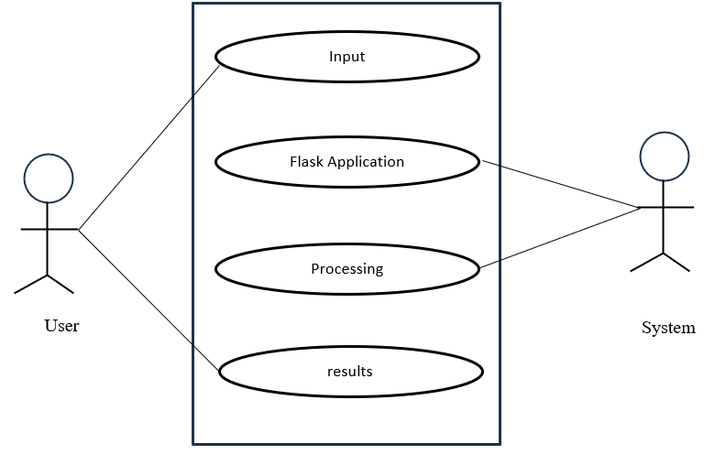
USE CASE DESIGN

Slide 68
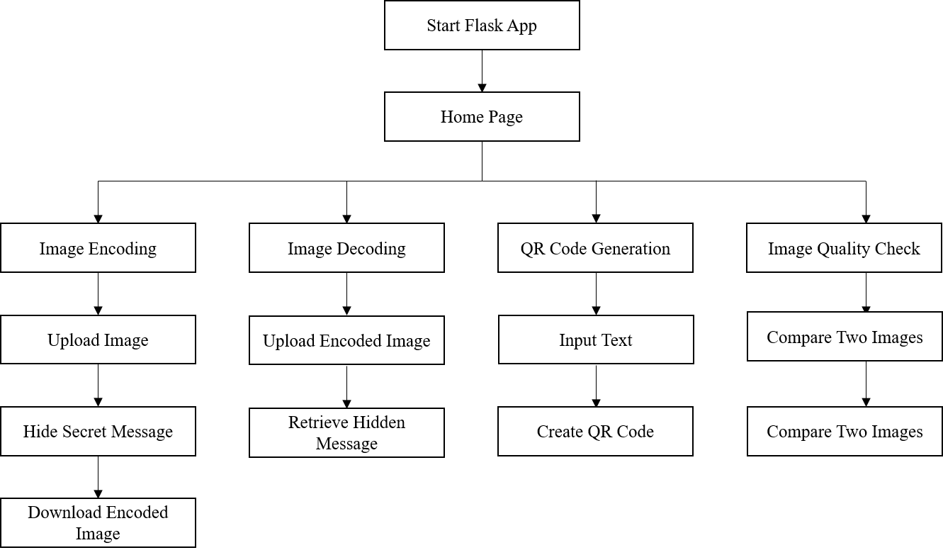
FLOW DIAGRAM

Slide 69
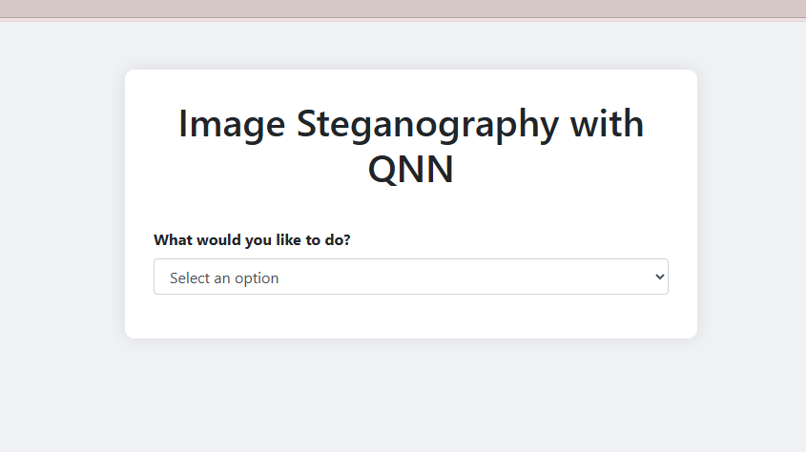
SCREENSHOT
Figure 7.1 : Snapshot of Home Page

Slide 70
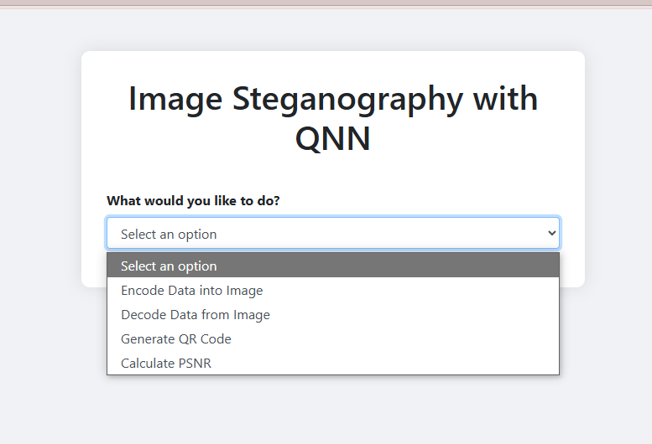
SCREENSHOT
Figure 7.2 : Snapshot of Home Page with Feature Selection

Slide 71
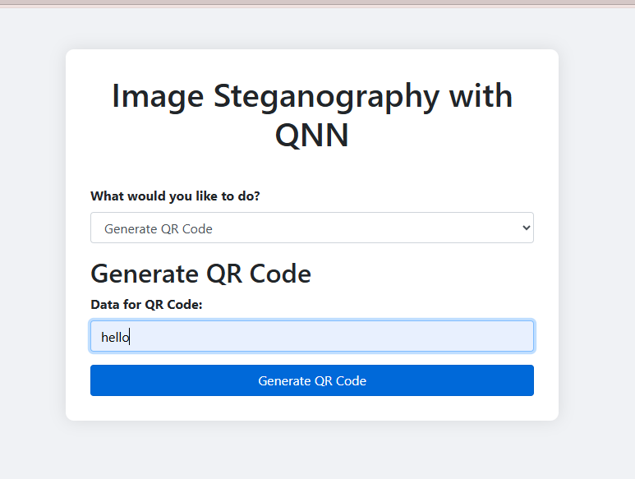
SCREENSHOT
Figure 7.3 : QR Code Generation Interface

Slide 72
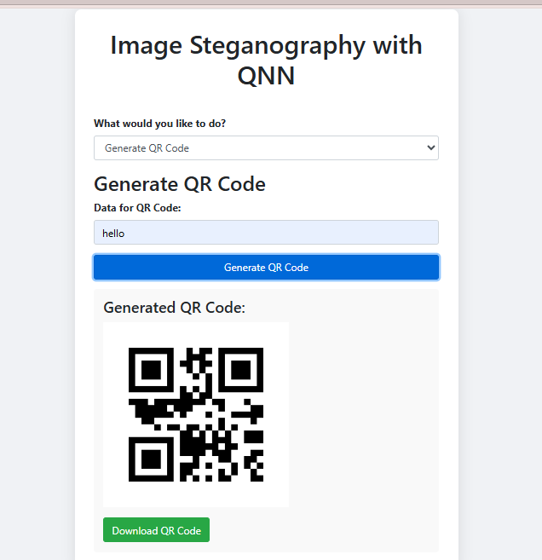
SCREENSHOT
Figure 7.4 : QR Code QR Code Generated Interface

Slide 73
SCREENSHOT
SCREENSHOT
Figure 7.5 : Data Encoding into Image using QNN

Slide 74
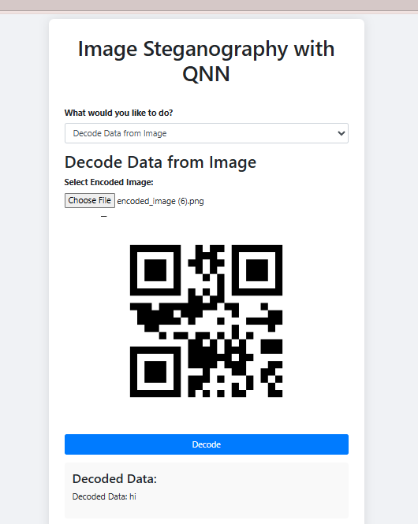
SCREENSHOT
SCREENSHOT
Figure 7.6 : Data Decoding into Image using QNN

Slide 75
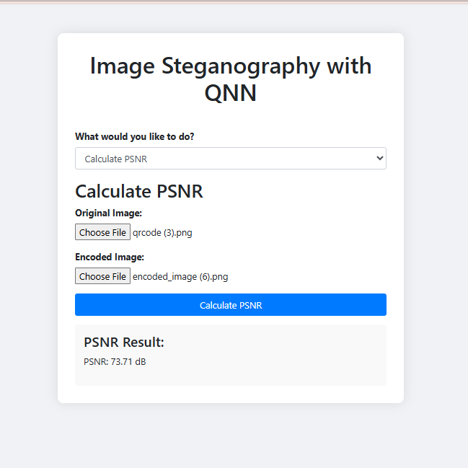
SCREENSHOT
SCREENSHOT
Figure 7.7 : PSNR Value Calculation Interface

Slide 76
REFERENCES
[1]. Jehn-Ruey Jiang “A Quick Overview of Quantum Machine Learning” IEEE 2023.
[2]. Manjunath T D, Biswajit Bhowmik “Quantum Machine Learning and Recent
Advancements” IEEE 2023.
[3]. Shahid Rahman, Jamal Uddin, MuhammHilal Ahmad Bhat, Farooq Ahmad Khanday,brajesh Kumar Kaushik, Faisal Bashir,and Khurshed Ahmad Shah “Quantum Computing: Fundamentals,Implementations and Applications” IEEE 2022.
[4] Zakarya,hameed Hussain, Ayaz Ali Khan, Aftab Ahmed And Muhammad Haleem “A Comprehensive Study of Digital Image Steganographic Techniques”IEEE 2023.
[5].S. Sravani, R. Ranjith ” Image Steganography For Confidential Data Communication” IEEE 2021.
[6]. Dr.Mayank Srivastava, Pratibha Dixit, Shikha Srivastava “Data Hiding using Image Steganography” IEEE 2023.
[7]. Juned Ahmed Mazumder, K. Hemachandra “Image Steganography Using the Fusion of Quantum Computation and Wavelet Transformation” IEEE 2019.
[8]. R S Randhawa, Amey R Hasabnis, Sanghmitra Rai “Quantum-Based Colour Image Steganography” IEEE 2023.
60

Slide 77
THANK YOU
64

